Slide 1
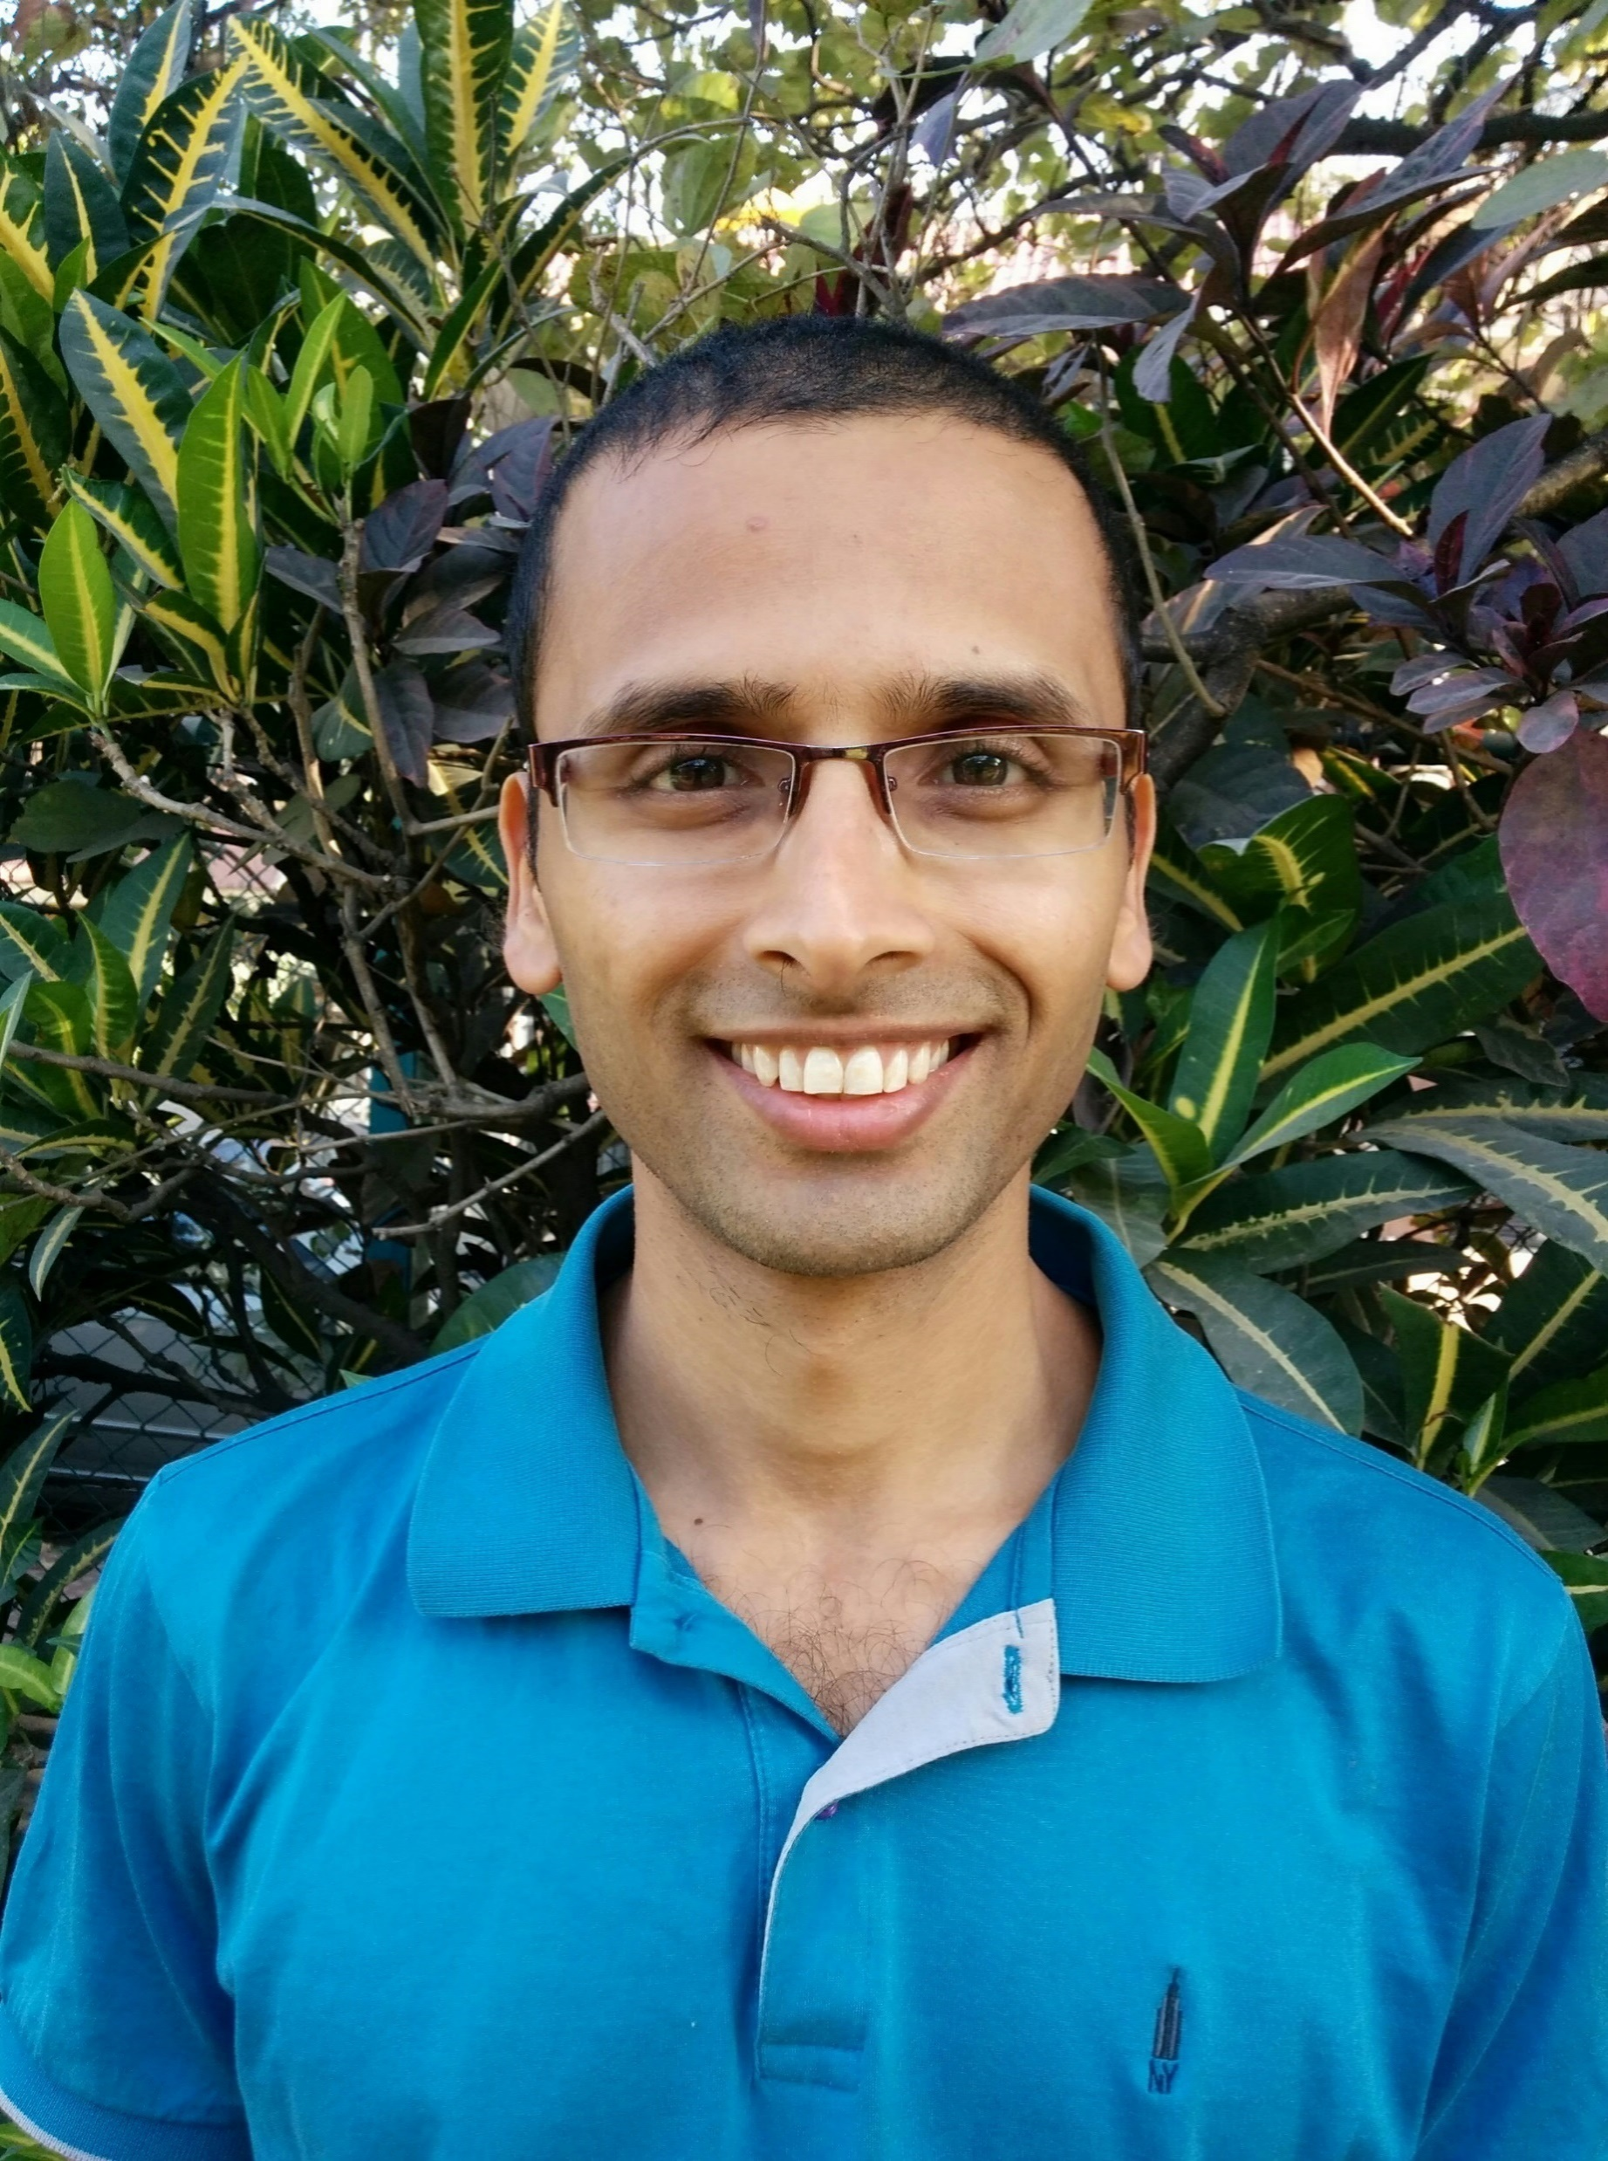
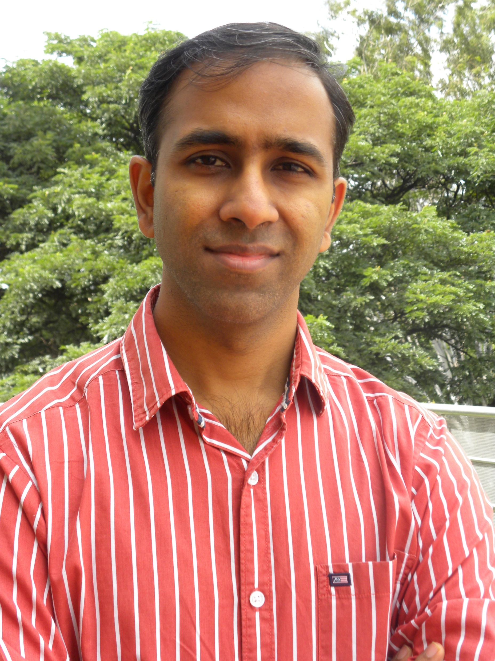
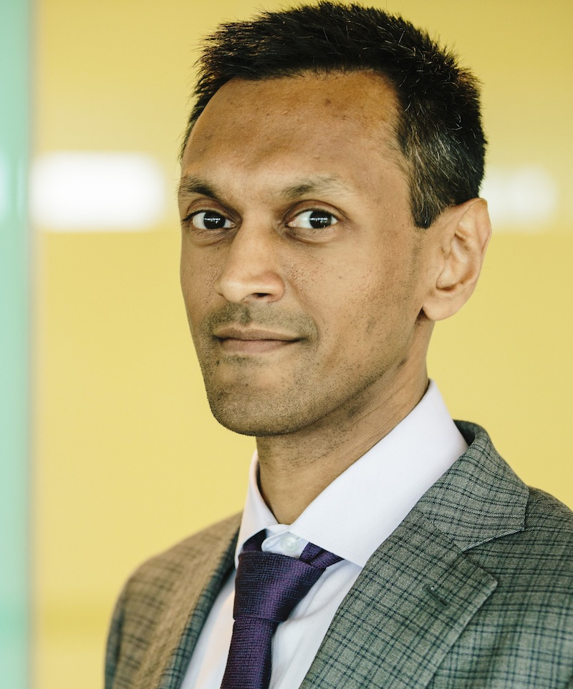



On the insufficiency of existing Momentum schemes for Stochastic Optimization
Speaker: Rahul Kidambi
Joint work with Praneeth Netrapalli, Prateek Jain, Sham M. Kakade
University of Washington, Seattle; Microsoft Research, India

Slide 2
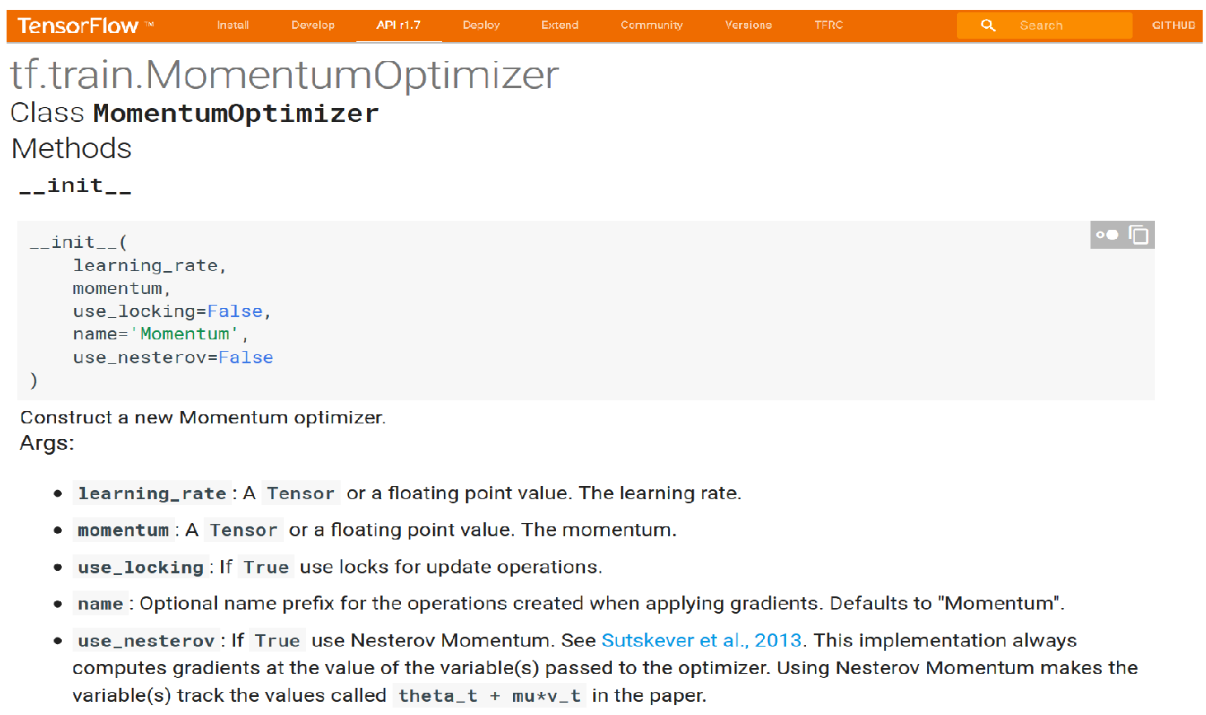
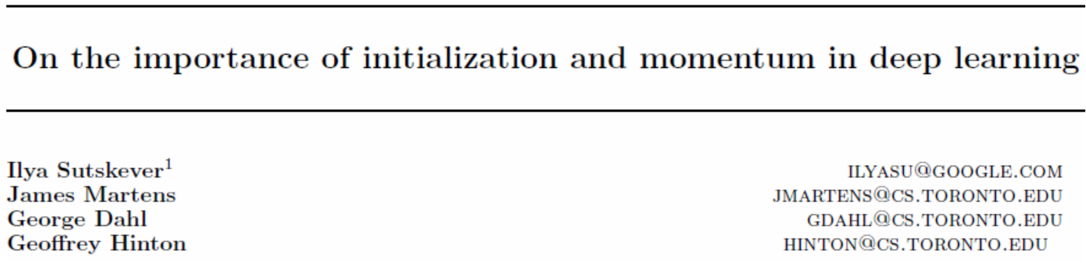
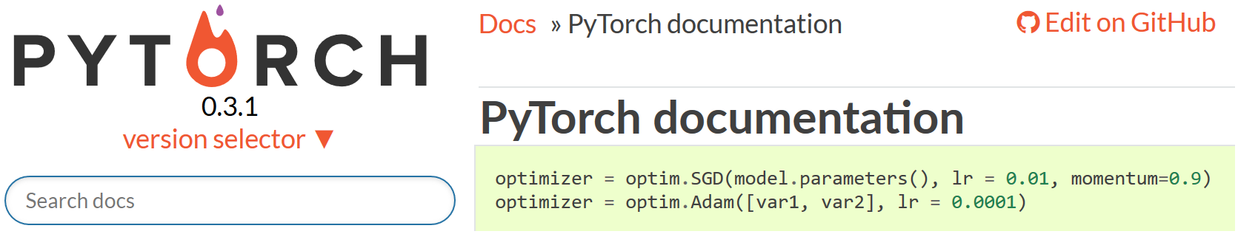
Momentum is important
Deeply influential. SGD means SGD + Heavy Ball/Nesterov’s Acceleration.
Broadly referred to as momentum methods.
Theory: improvement when used with exact gradients
Practice: used with stochastic gradients
This paper:
Rigorous understanding of momentum with stochastic gradients
By considering linear regression.

Slide 3
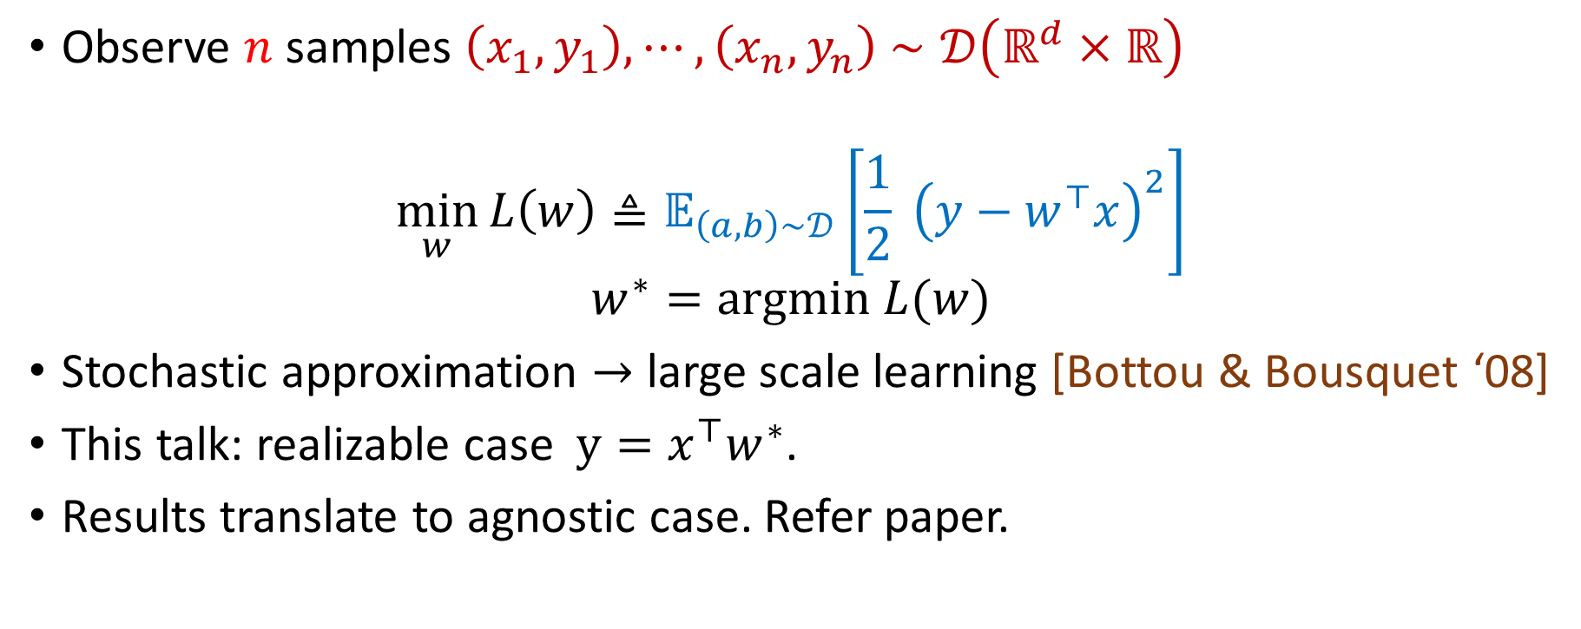
Problem setup: stochastic approximation
Observe $n$ samples $\left(x_{1},y_{1}\right),⋯,\left(x_{n},y_{n}\right)$ $∼𝒟\left(ℝ^{d}×ℝ\right)$
$$\min_{w}{L\left(w\right)≜𝔼_{\left(a,b\right)∼𝒟}\left[\frac{1}{2} {\left(y−w^{⊤}x\right)}^{2}\right]}$$
$$w^{∗}=argmin L(w)$$
Stochastic approximation $→$ large scale learning [Bottou & Bousquet ‘08]
This talk: realizable case $y=x^{⊤}w^{∗}$.
Results translate to agnostic case. Refer paper.

Slide 4
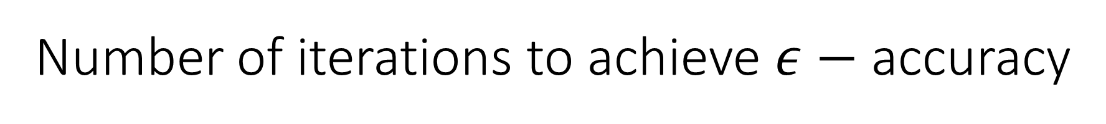
Number of iterations to achieve $ε−$ accuracy
Deterministic Gradients | Stochastic Gradients
Gradient Descent | SGD
NAG/HB | SGD+NAG/SGD+HB

Slide 5
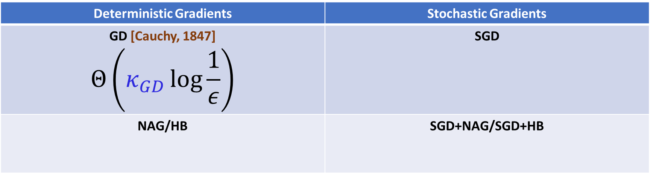

Number of iterations to achieve $ε−$ accuracy
Deterministic Gradients | Stochastic Gradients
GD [Cauchy, 1847] $$Θ\left(κ_{GD}\log{\frac{1}{ε}}\right)$$ | SGD
NAG/HB | SGD+NAG/SGD+HB
Hessian $H=E[xx^{⊤}]$
$$κ_{GD}=\frac{λ_{max}\left(H\right)}{λ_{min}(H)}$$

Slide 6
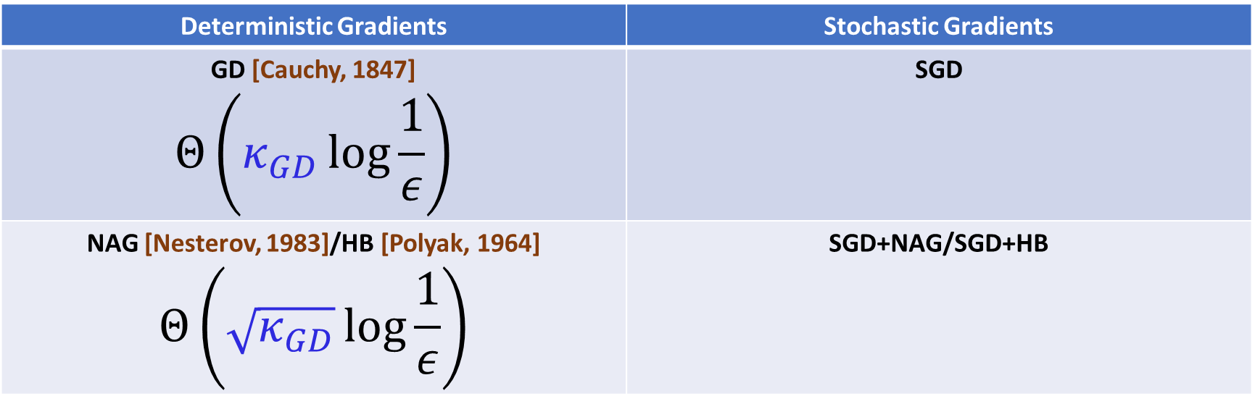

Number of iterations to achieve $ε−$ accuracy
Deterministic Gradients | Stochastic Gradients
GD [Cauchy, 1847] $$Θ\left(κ_{GD}\log{\frac{1}{ε}}\right)$$ | SGD
NAG [Nesterov, 1983]/HB [Polyak, 1964] $$Θ\left(\sqrt{κ_{GD}}\log{\frac{1}{ε}}\right)$$ | SGD+NAG/SGD+HB
Hessian $H=E[xx^{⊤}]$
$$κ_{GD}=\frac{λ_{max}\left(H\right)}{λ_{min}(H)}$$

Slide 7
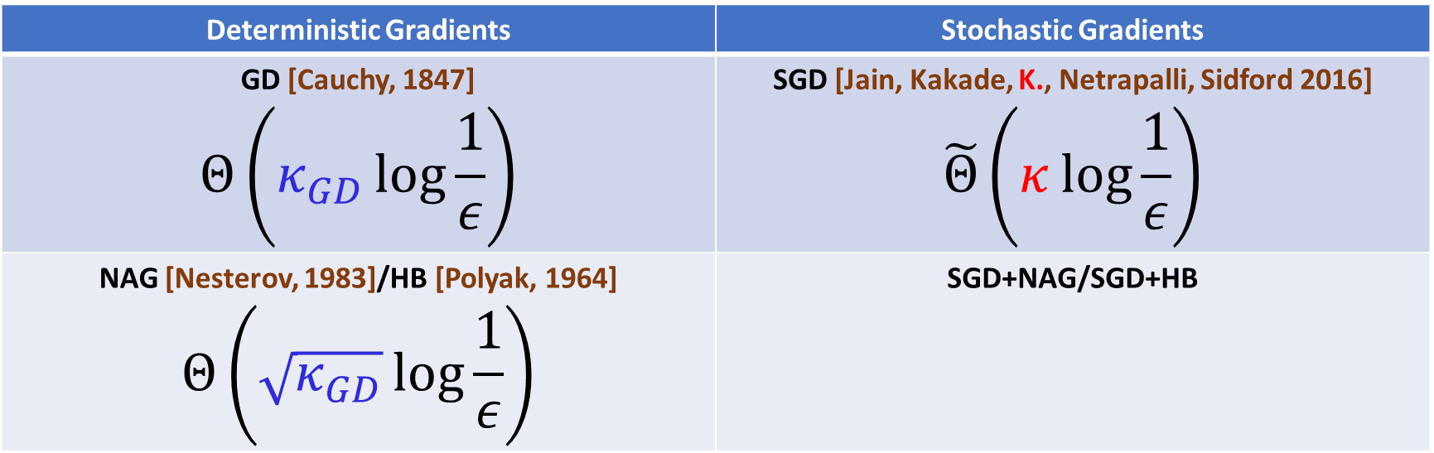
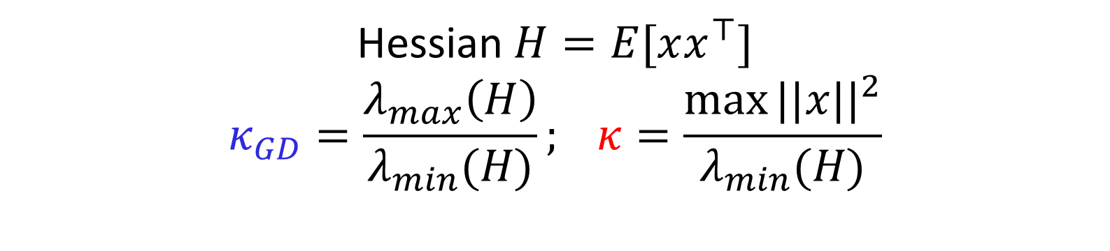
Number of iterations to achieve $ε−$ accuracy
Deterministic Gradients | Stochastic Gradients
GD [Cauchy, 1847] $$Θ\left(κ_{GD}\log{\frac{1}{ε}}\right)$$ | SGD [Jain, Kakade, K., Netrapalli, Sidford 2016] $$\tilde{Θ}\left(κ\log{\frac{1}{ε}}\right)$$
NAG [Nesterov, 1983]/HB [Polyak, 1964] $$Θ\left(\sqrt{κ_{GD}}\log{\frac{1}{ε}}\right)$$ | SGD+NAG/SGD+HB
Hessian $H=E[xx^{⊤}]$
$$κ_{GD}=\frac{λ_{max}\left(H\right)}{λ_{min}(H)}; κ=\frac{\max{||x||^{2}}}{λ_{min}(H)}$$

Slide 8
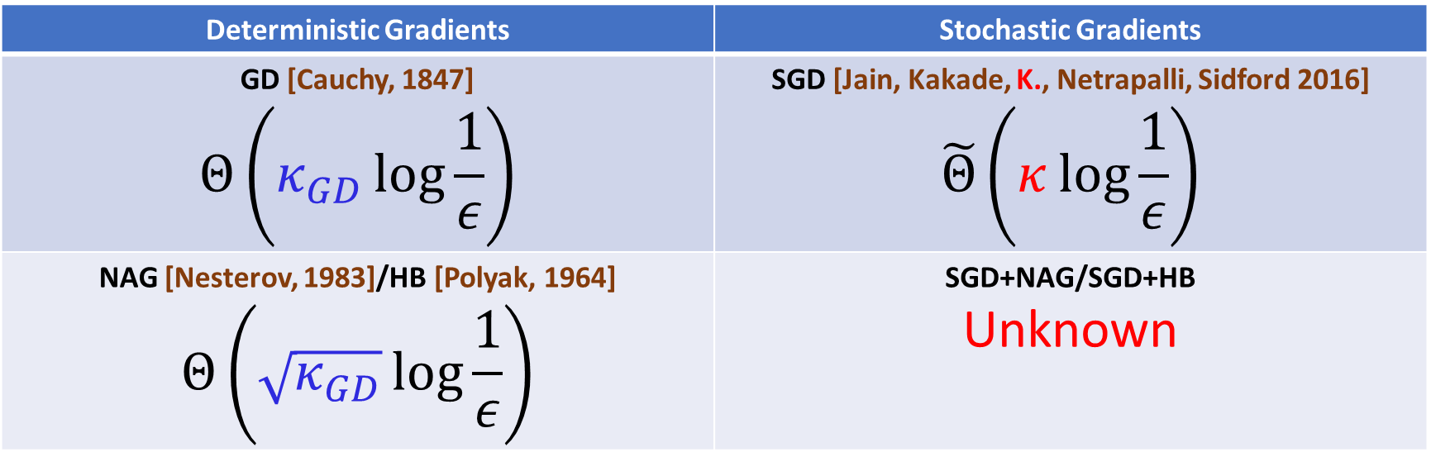
Number of iterations to achieve $ε−$ accuracy
Deterministic Gradients | Stochastic Gradients
GD [Cauchy, 1847] $$Θ\left(κ_{GD}\log{\frac{1}{ε}}\right)$$ | SGD [Jain, Kakade, K., Netrapalli, Sidford 2016] $$\tilde{Θ}\left(κ\log{\frac{1}{ε}}\right)$$
NAG [Nesterov, 1983]/HB [Polyak, 1964] $$Θ\left(\sqrt{κ_{GD}}\log{\frac{1}{ε}}\right)$$ | SGD+NAG/SGD+HB Unknown

Slide 9
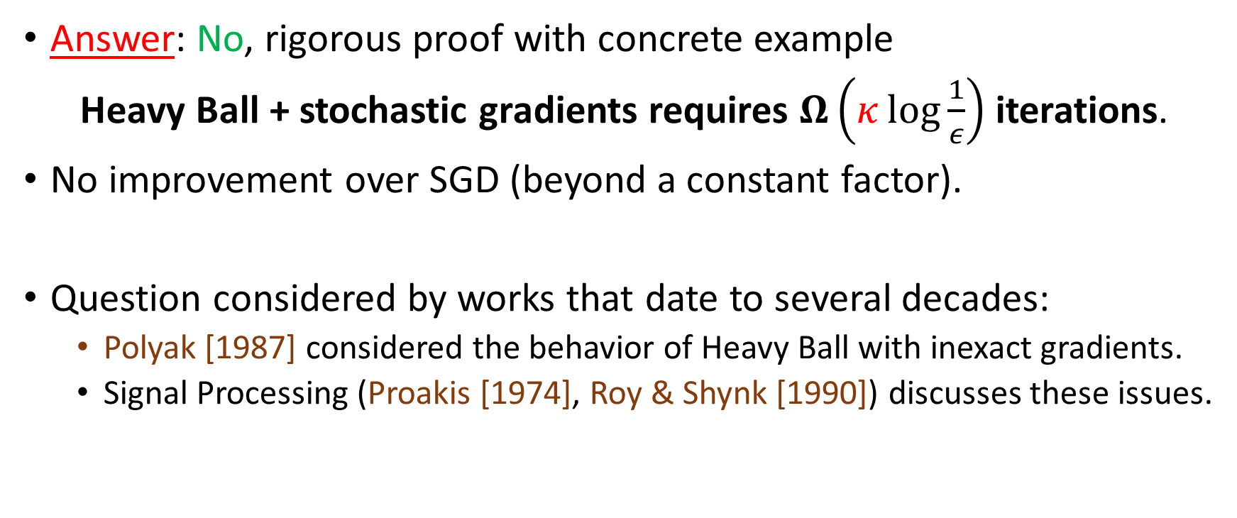
Question 1: Does stochastic HB/NAG improve over SGD??
Answer: No, rigorous proof with concrete example
Heavy Ball + stochastic gradients requires $Ω\left(κ\log{\frac{1}{ε}}\right)$ iterations.
No improvement over SGD (beyond a constant factor).
Question considered by works that date to several decades:
Polyak [1987] considered the behavior of Heavy Ball with inexact gradients.
Signal Processing (Proakis [1974], Roy & Shynk [1990]) discusses these issues.

Slide 10
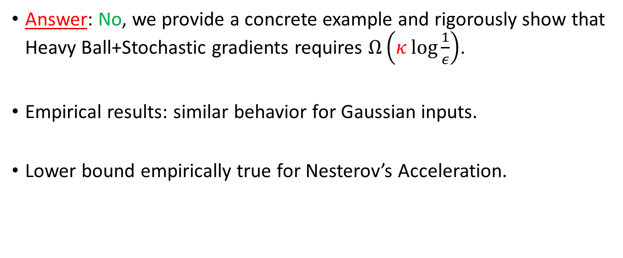
Question 1: Does stochastic HB/NAG improve over SGD??
Answer: No, we provide a concrete example and rigorously show that Heavy Ball+Stochastic gradients requires $Ω\left(κ\log{\frac{1}{ε}}\right)$.
Empirical results: similar behavior for Gaussian inputs.
Lower bound empirically true for Nesterov’s Acceleration.

Slide 11
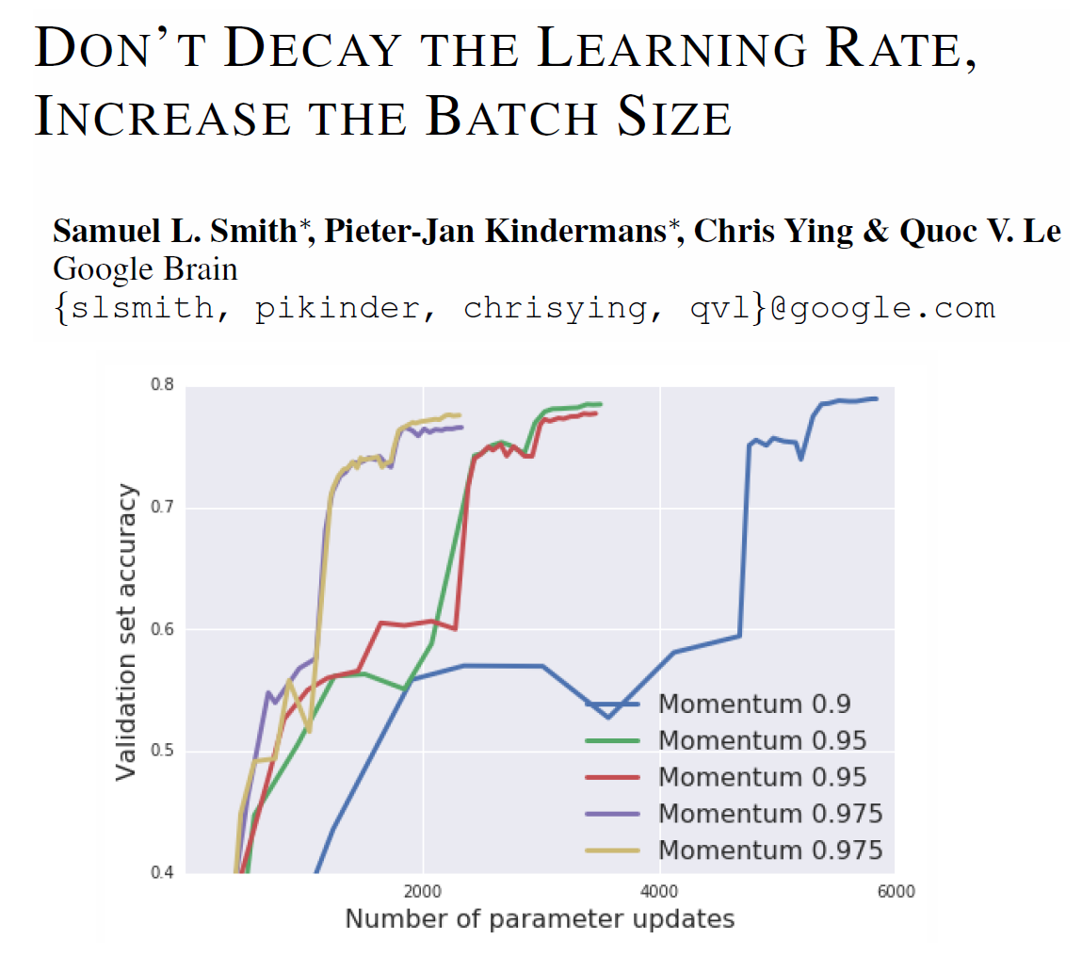
Why is momentum effective in practice?
One answer: mini-batching!
Moves stochastic gradients ``closer’’ to exact gradients.
How much mini-batching required? Often, very large!

Slide 12
Understanding SGD better
Subtle interplay of learning rate, batch size, momentum.
Our work: precise understanding of these tradeoffs.
Jain, Kakade, K., Netrapalli, Sidford 2016: Parallelization of SGD via mini-batching.
This work addresses momentum issues.
Key tool: SGD viewed as a stochastic process.
captures SGD’s behavior on every problem instance.
Not a worst case characterization.

Slide 13
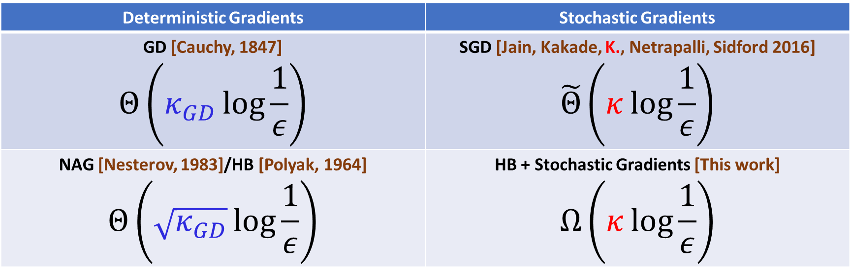
Number of iterations to achieve $ε−$ accuracy
Deterministic Gradients | Stochastic Gradients
GD [Cauchy, 1847] $$Θ\left(κ_{GD}\log{\frac{1}{ε}}\right)$$ | SGD [Jain, Kakade, K., Netrapalli, Sidford 2016] $$\tilde{Θ}\left(κ\log{\frac{1}{ε}}\right)$$
NAG [Nesterov, 1983]/HB [Polyak, 1964] $$Θ\left(\sqrt{κ_{GD}}\log{\frac{1}{ε}}\right)$$ | HB + Stochastic Gradients [This work] $$Ω\left(κ\log{\frac{1}{ε}}\right)$$

Slide 14
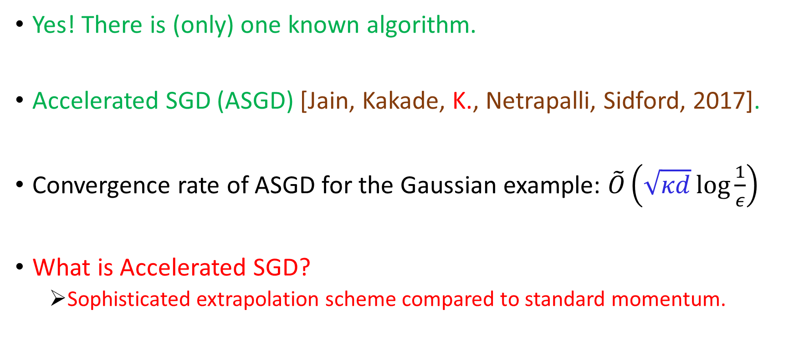
Question 2: Does any algorithm provably improve over SGD?
Yes! There is (only) one known algorithm.
Accelerated SGD (ASGD) [Jain, Kakade, K., Netrapalli, Sidford, 2017].
Convergence rate of ASGD for the Gaussian example: $\tilde{O}\left(\sqrt{κd}\log{\frac{1}{ε}}\right)$
What is Accelerated SGD?
Sophisticated extrapolation scheme compared to standard momentum.

Slide 15
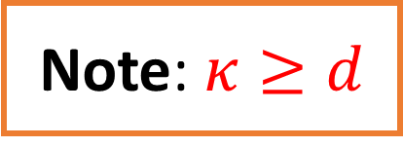
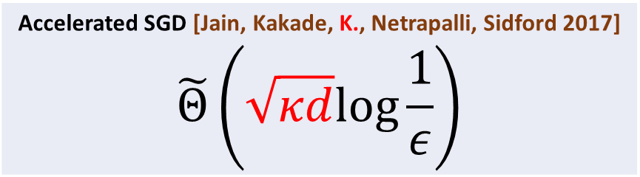
Number of iterations to achieve $ε−$ accuracy
Deterministic Gradients | Stochastic Gradients
GD [Cauchy, 1847] $$Θ\left(κ_{GD}\log{\frac{1}{ε}}\right)$$ | SGD [Jain, Kakade, K., Netrapalli, Sidford 2016] $$\tilde{Θ}\left(κ\log{\frac{1}{ε}}\right)$$
NAG [Nesterov, 1983]/HB [Polyak, 1964] $$Θ\left(\sqrt{κ_{GD}}\log{\frac{1}{ε}}\right)$$ | HB + Stochastic Gradients [This work] $$Ω\left(κ\log{\frac{1}{ε}}\right)$$
Accelerated SGD [Jain, Kakade, K., Netrapalli, Sidford 2017] $$\tilde{Θ}\left(\sqrt{κd}log{\frac{1}{ε}}\right)$$
Note: $κ≥d$

Slide 16
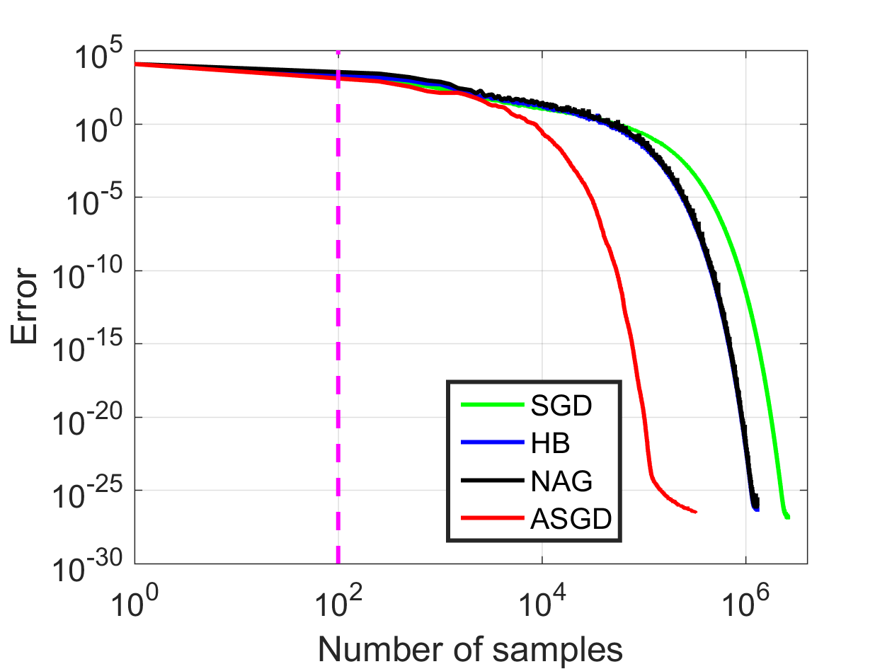
Comparing ASGD with stochastic HB/NAG and SGD with Gaussian inputs

Slide 17
Recap:
Do existing algorithms (stochastic HB/NAG) improve over SGD?
No, they are no better than SGD.
Is there any algorithm that can improve over SGD?
Yes, there exists one algorithm (called, Accelerated SGD).

Slide 18
Broader applicability of ASGD
Benchmarked for training deep neural networks.
Deep Autoencoders (11 layer multi-layer perceptron). See paper.
44-layer Resnet (He et al. 2016) for CIFAR-10.

Slide 19
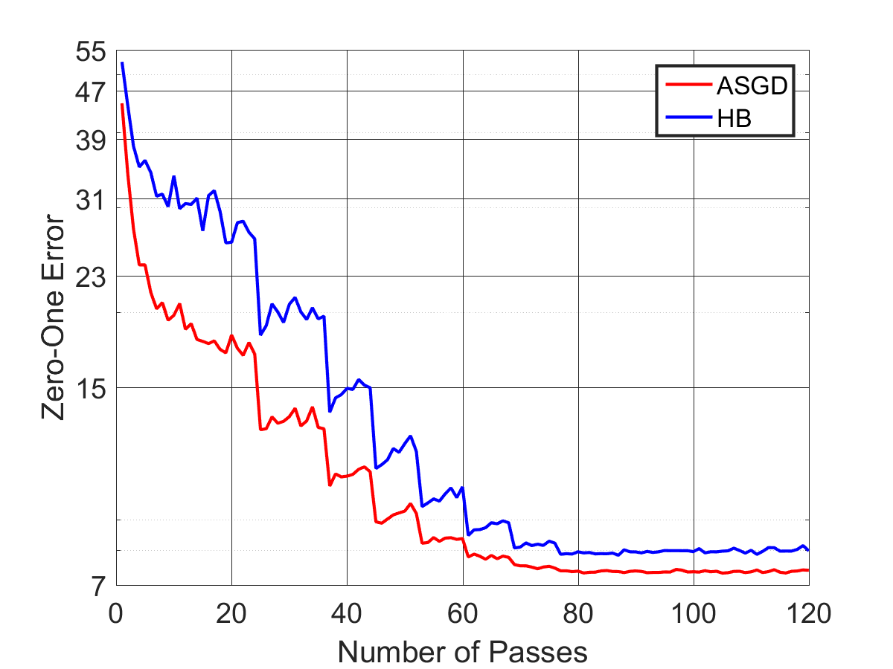
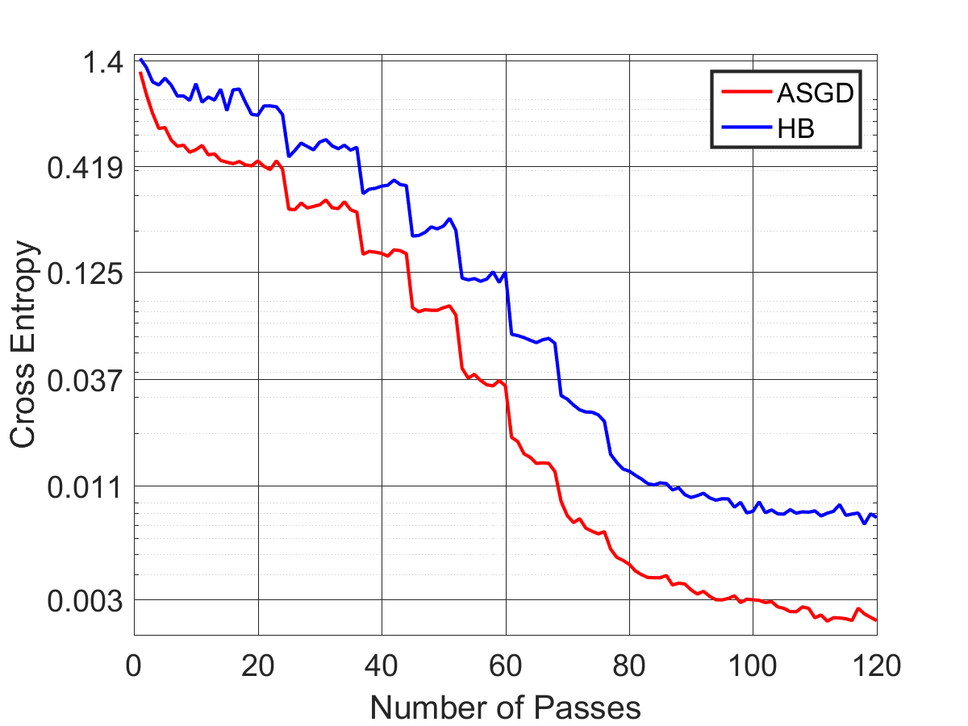
Resnet-44: ASGD vs. HB (batch size 128)
Zero-One Error on Test Data
Function value on Training data

Slide 20
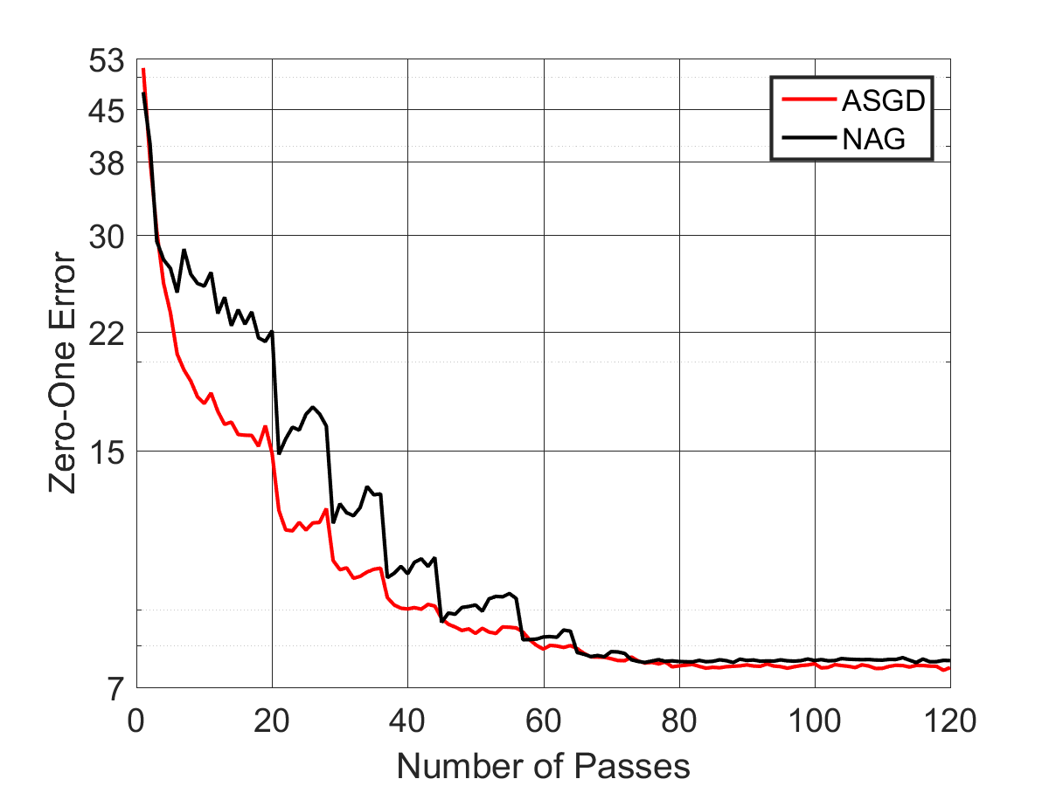
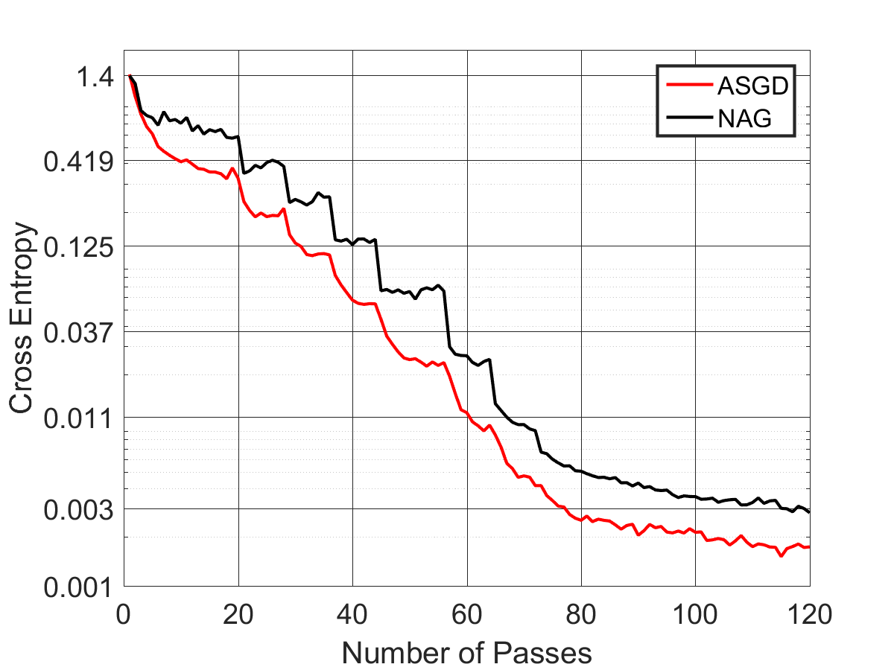
Resnet-44: ASGD vs. NAG (batch size 128)
Zero-One Error on Test Data
Function value on Training data

Slide 21
Concluding remarks:
Be(a)ware of stochastic variants of deterministic accelerated methods.
Mini-batching allows exciting speedups; not the best for every batch size.
Dedicated accelerated methods for stochastic gradients: much better!
One provable algorithm known (Accelerated SGD)
Pytorch code for ASGD optimizer released. See paper!
Plenty more such algorithms needed!

Slide 22
Thank you

